Slide 1

NFC ACADEMY
For Homeschool Families
Fully Accredited
Middle States Commission on Colleges and Schools
Florida Association of Christian Colleges and Schools
A Biblical Worldview Curriculum
Affordable Tuition
Homeschool Edition Program (Grades 3-7)
Homeschool Advantage Program (Grades 3-12)
Certified Teachers
Notes:
Welcome to NFC Academy, a Christian school program for homeschool families that is all online. NFC Academy is fully accredited by the Regional Accrediting Association of the Middles States Commission of Colleges and Schools and is also accredited by the Florida Association of Christian Colleges and Schools.
Using a Biblical Worldview curriculum NFC Academy is affordable and all teachers are certified in their teaching area. Now, let’s learn more about this exciting educational program.
(You may want to print this presentation in handout or note format.)

Slide 2

Getting Started
Notes:
Today, we will go over the basics of how you use the NFC Academy Ignitia Learning Program.
Before we get into how you use it, let’s talk about what it is in the first place.
(Next slide)

Slide 3


What is it?
ON
Notes:
What is NFC Academy Ignitia?
Simply, it is school on the web for grades 3-12. Today you can name most any activity and it is conducted over the Internet. This is the digital age for learning which can be seen by the growing use of tablets and other devices for education. Online learning is growing everywhere and NFC Academy brings a fully accredited program to you right where you are on the Internet.
(You may choose to ask students questions that invite discussion such as:
How many of you use the Internet?
What do you like to do on the Internet?
Why do you like the Internet?
What kinds of things would you like to do on the Internet if you could?
(Field questions, encourage discussion and have fun with students.)
(Next slide)

Slide 4

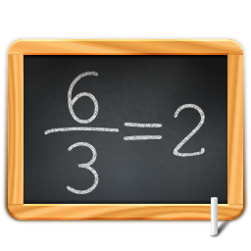


Notes:
We’ve said that most everything is being done over the Internet today and this learning brings things you like to your education. Here’s what I think you’ll like about Ignitia. The lessons you will be doing have a lot of the things you like about the Internet such as games, cool videos, and interesting things to read and listen to.
So it’s schoolwork and it’s a fun way to do it – the digital way!
(Next slide)

Slide 5


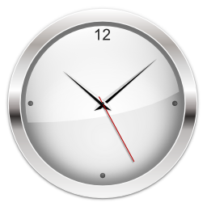

Internet
Devices
24/7
Notes:
Now here’s the really cool thing. A couple of minutes ago I told you that NFC Academy’s Ignitia is school on the web, right? What that means is that you can do your work pretty much anywhere you have the Internet. Like home, the library, stores, and restaurants. Wherever you travel, you can take your school with you.
Ignitia also works on many cell phones and tablets, again, if you have the Internet on it. It won’t work on all devices but if you have one, you should check to see if it works.
One other thing I want you to know is that since Ignitia is on the Internet, it’s available to you 24 hours 7 days a week, all year round so feel free to work on your assignments anytime you want. I like this because it makes it flexible. You work on your own schedule. It is important to keep up and we will help you do that.
(Next slide)

Slide 6

Things to know
Notes:
Ok, we’ve talked about what Ignitia is, and where and when you can use it.
There are 3 things you need to know about HOW to use Ignitia.
(Next slide)

Slide 7
Write this down!!!
How to log in
How to do assignments
How to track my progress
Notes:
We are going to show you 3 things -
First “How to log in”
Next “How to do assignments”
And last “How to track my progress”
(Next slide)

Slide 8
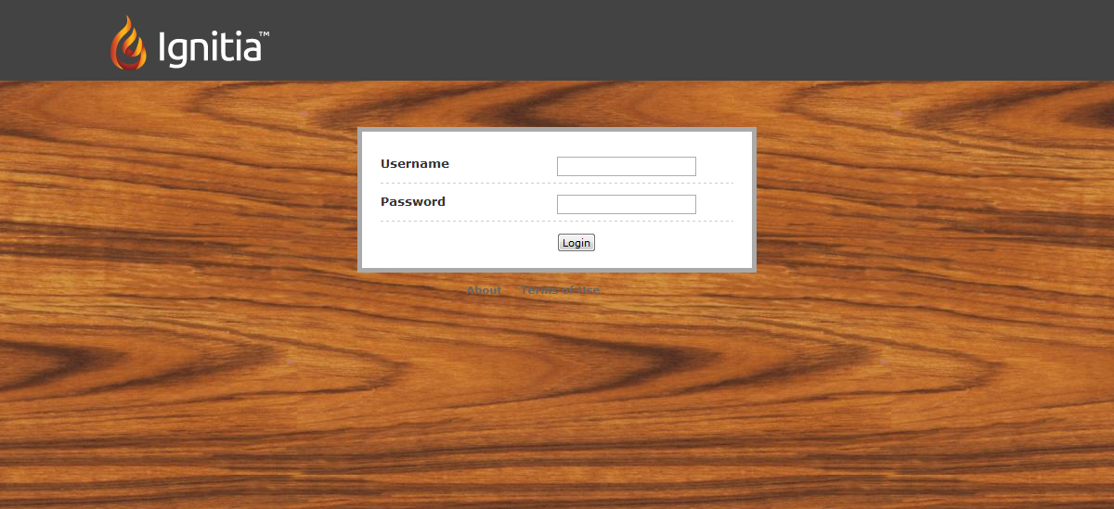
1. How to log in
http://www.nflcacademy.com/
Notes:
First, let’s talk about how to login to the program.
See the url that is on the slide? That is NFC Academy and you will see the link to your student login at the top of the screen. That will take you to the login which is what you see on the screen now. You will want to bookmark this website on your computer so it’s easy to find when you need it.
Each of you will be assigned a username and password that you will use to access the site. When you come to the login screen you will need to enter your login ID here and your Password here. Then, click the Login button here.
Once you’re logged in, the first thing you’ll see is your home page where you can see your upcoming assignments. And that brings us to number 2.
(Next slide)

Slide 9
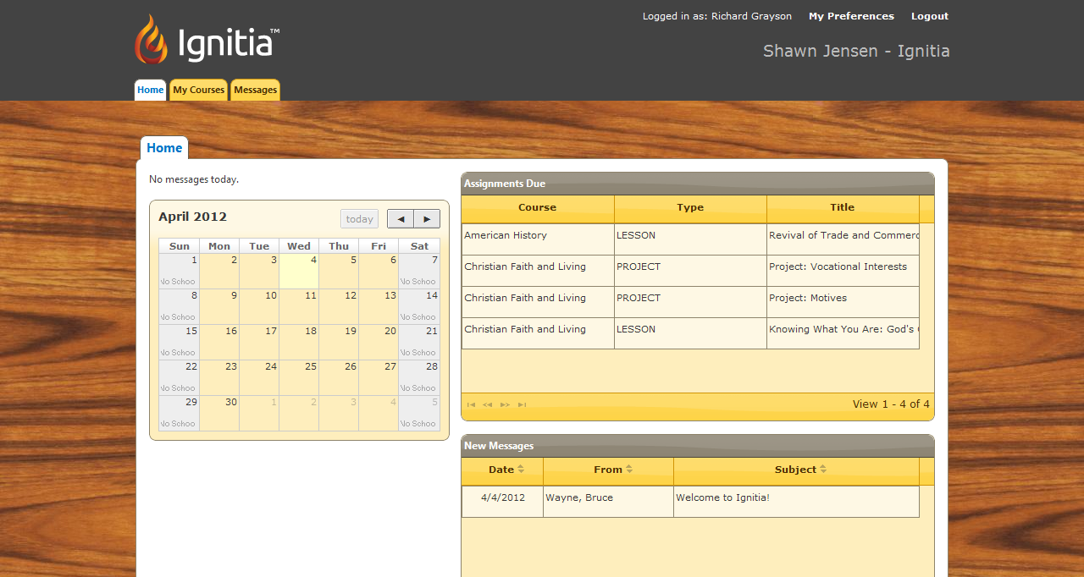
2. How to do assignments
Notes:
Starting assignments is super easy. In the Assignments Due box, you’ll get a list of the assignments that are due next. To start an assignment, all you have to do is click on the assignment you want to work on and it will open immediately.
(Next slide)

Slide 10
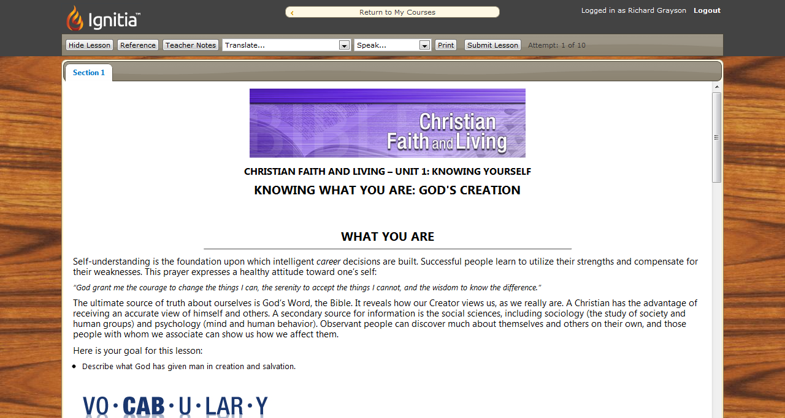
2. How to do assignments
Notes:
Here’s an example of a typical lesson in Ignitia. There will be an introduction with the objectives for the lesson, followed by vocabulary. The rest of the lesson will be made up of things you READ and things you DO. You’ll also have questions to answer at the end of the lesson.
Make sure you answer ALL the questions for ALL sections within the assignment.
(Highlight the Section 1 tab at the top and let students know they will sometimes have more than one section they have to complete.)
To submit an answer, click the Submit Answer button. When you have answered all the questions and you’re ready to turn in your assignment, click the Submit Lesson button at the top of the screen.
To pass a lesson, you need to get 70% or better. If you don’t pass the assignment, you will need to do it again. That’s no fun so make sure you pay attention the first time around!
(Field any questions students have about how to do lessons.)
(Next slide)

Slide 11
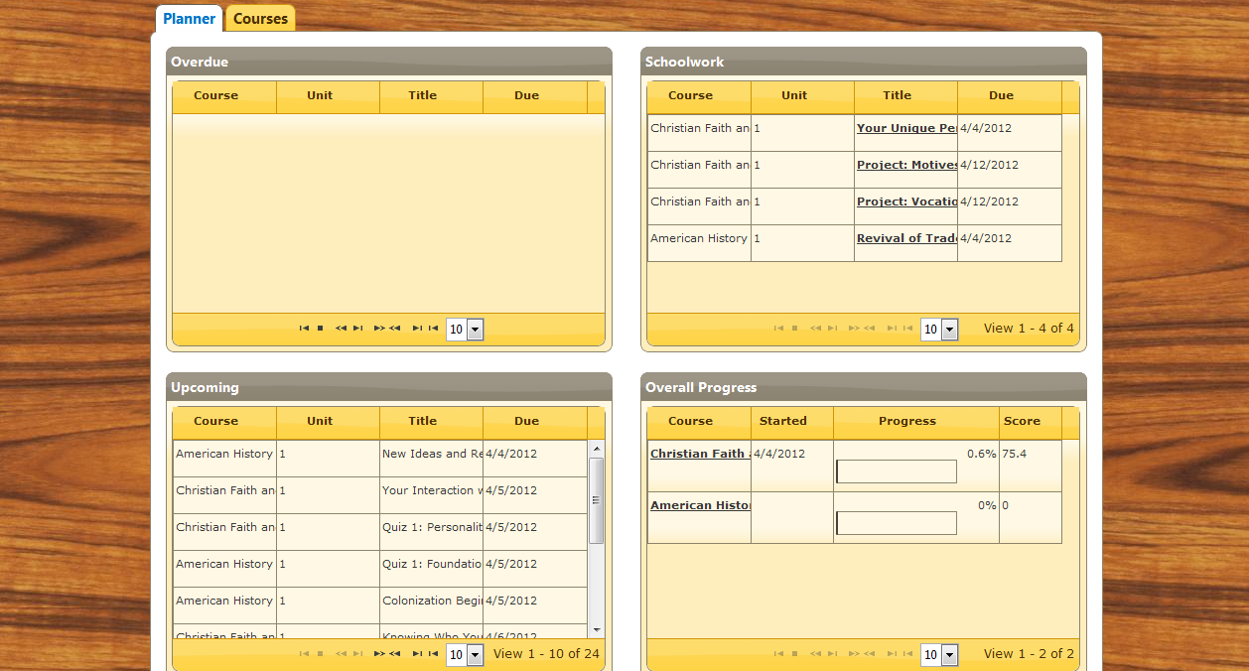
3. How to track progress
Notes:
Ok, now that you know how to log in and how do lessons in Ignitia, let me show you how to keep track of what you’ve done.
Start by clicking the My Courses tab. The Planner tab will probably what will show up first.
The Planner gives you a big picture view of all of your Ignitia work all on one page.
You will see:
Overdue work – Shows schoolwork that is past due
Schoolwork – Shows the next assignments you need to complete
Upcoming – Shows the assignments which will be due in the next 5 days
Overall Progress – Shows the progress you’ve made in each of your Ignitia courses, along with your total score in each course.
(Next slide)

Slide 12
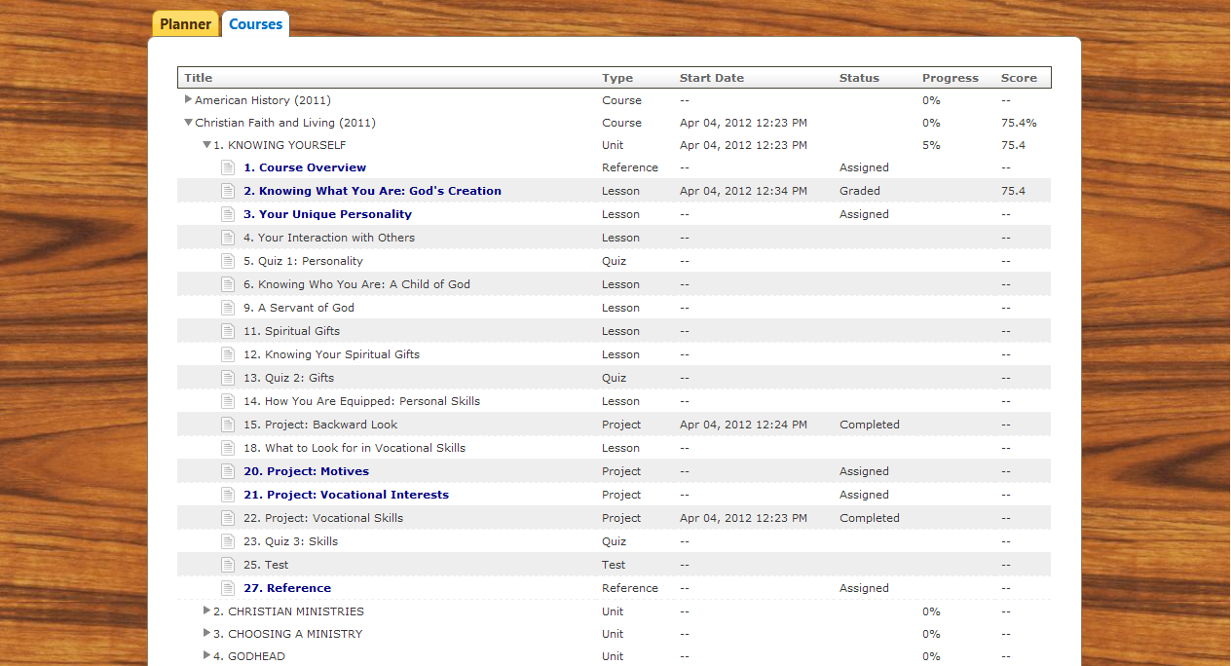
3. How to track progress
Notes:
To see all of your current progress in each of your courses, click on the Courses tab.
You will see listed each of the Ignitia courses you are enrolled in.
If you click on a course, the units open below it. If you click on a unit, you’ll see each of the assignments along with your total score. You can click on any assignment to review it after you’ve completed it.
(Field any questions about how to access courses and track progress in the program)

Slide 13
NFC Academy
WebEx Meetings
nfcadaemy@nflchurch.com
Notes:
In a nutshell that is it. We cover more in our live WebEx online meetings. You can join one of our meetings using your computer and we will show you more and answer any questions you have.
Our meeting times are listed on the NFC Academy web site’s home page, or we can schedule a personal time that works best for you.

Slide 14

Thank you and have fun!
Notes:
Thank you for taking this look at NFC Academy…we look forward to showing you more with our live online presentation.

